Slide 1
Using Ruby
Single command
Interactive Ruby Shell
Ruby File

Slide 2
Single Command
Ruby –v
ruby -e 'puts 123’

Slide 3
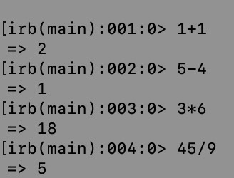
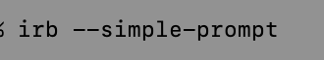
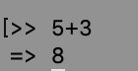
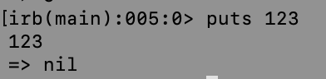
Interactive Ruby Shell (IRB)

Slide 4
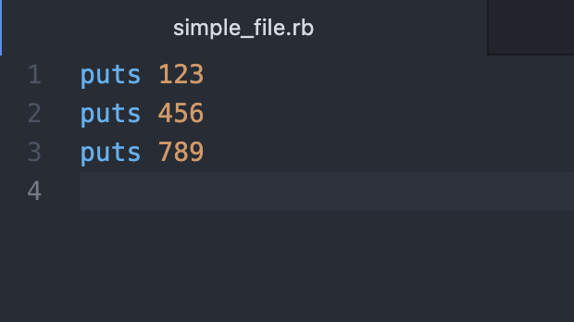
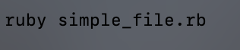
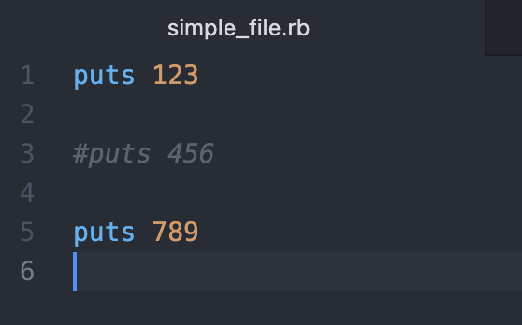
Ruby File

Slide 5
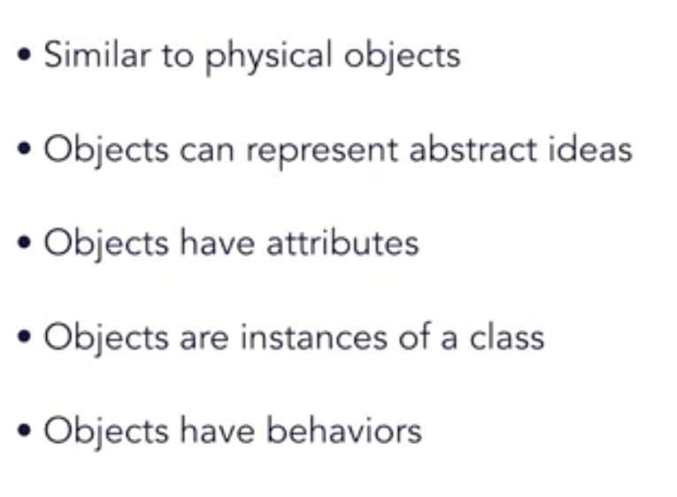
Object

Slide 6
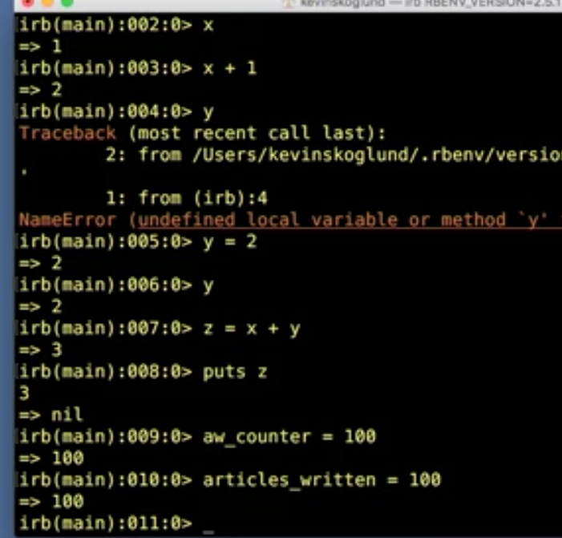
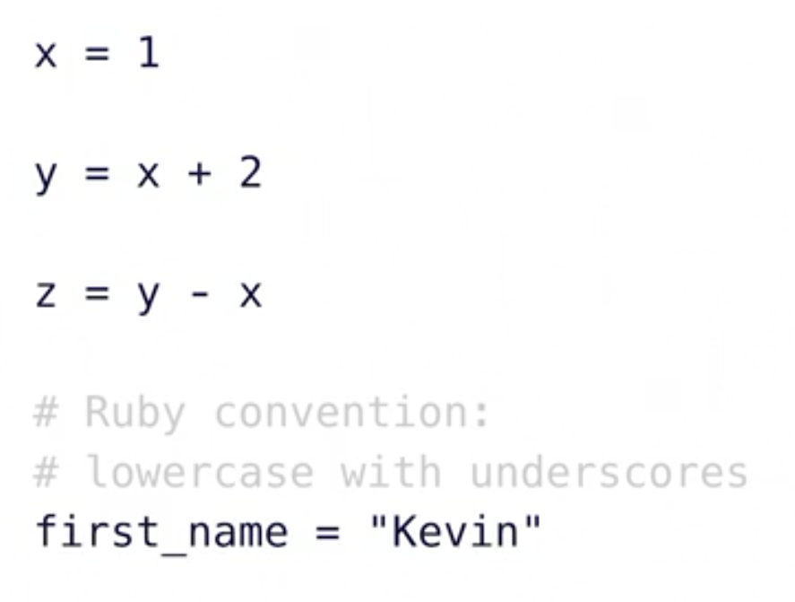
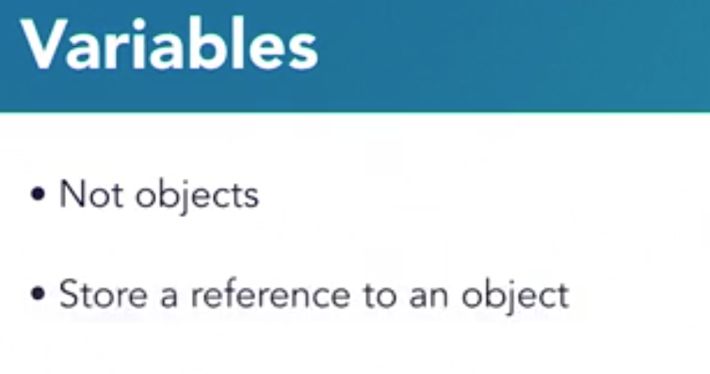
Variable

Slide 7
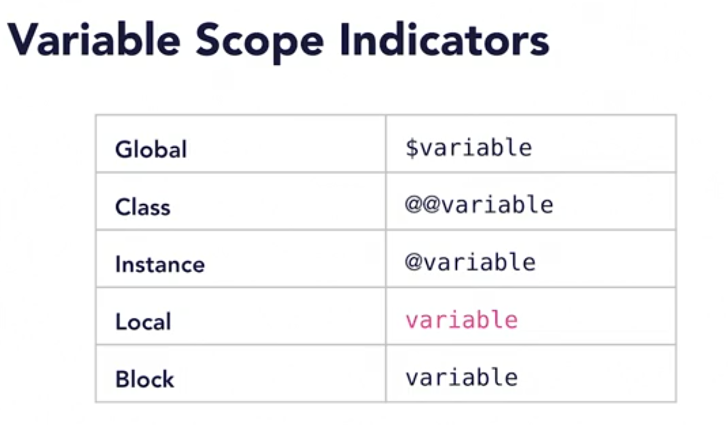

Slide 8
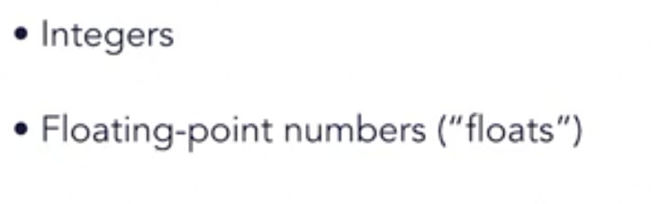
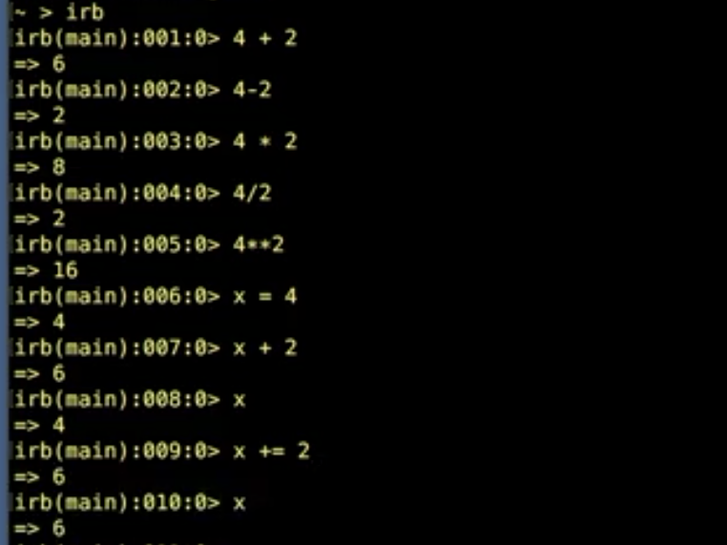
Numbers
4**2
X+=2
123.class

Slide 9
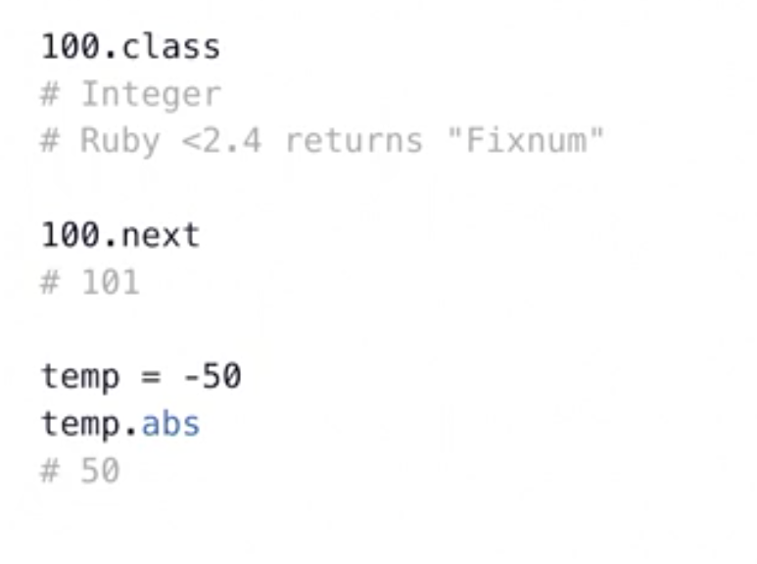
Integer Methods

Slide 10
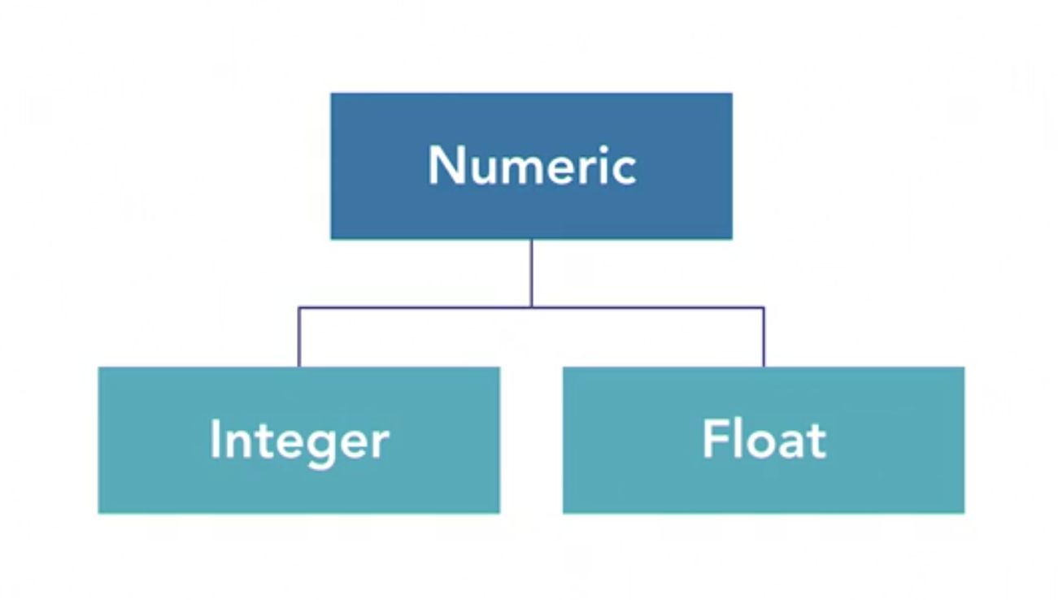

Slide 11
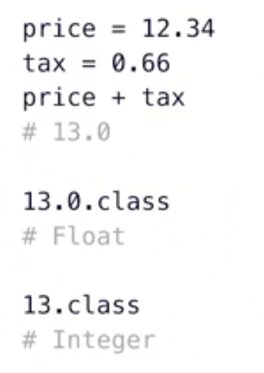
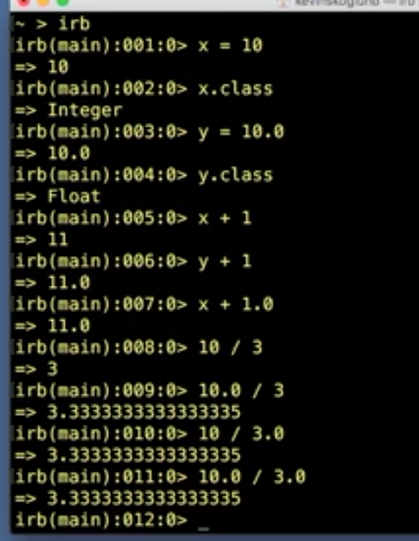
Floats

Slide 12
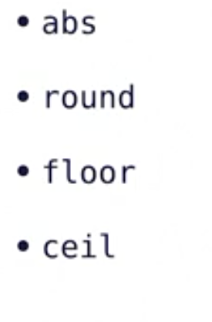
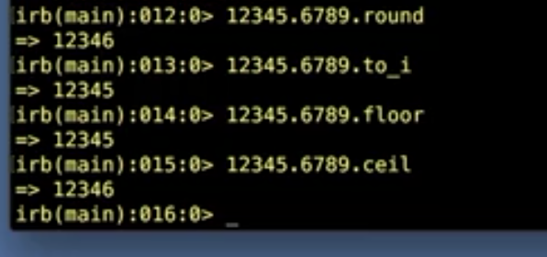
Floats methods

Slide 13
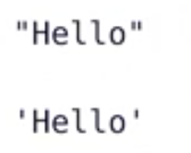
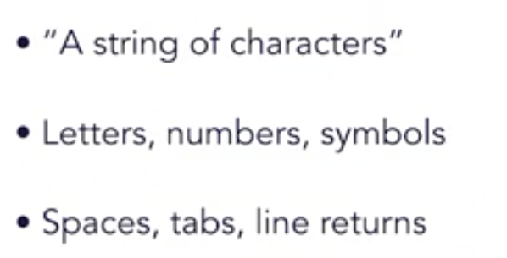
string
A sequence of characters

Slide 14
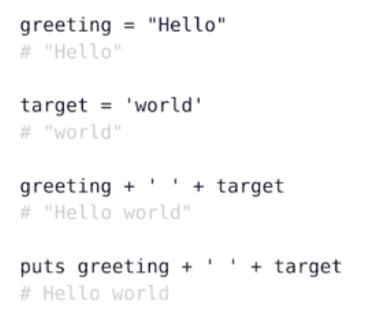
String:concatenations

Slide 15
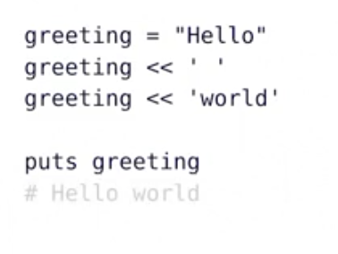
Strings Append

Slide 16
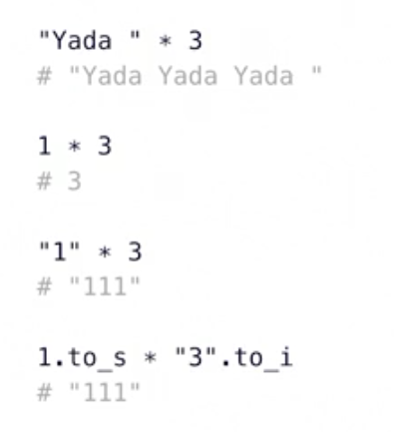
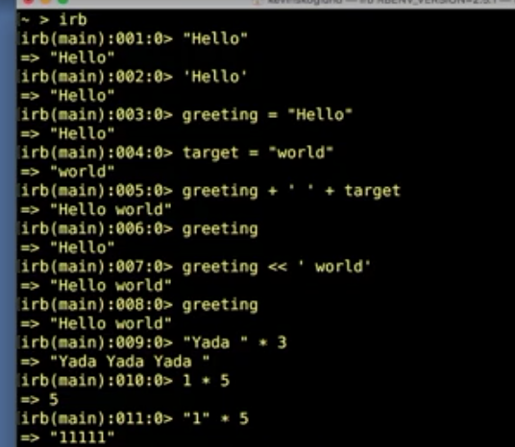
Strings:Multiplication

Slide 17
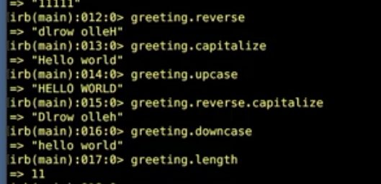
String Methods
Reverse
Capitalize
Upcase
Downcase
length

Slide 18
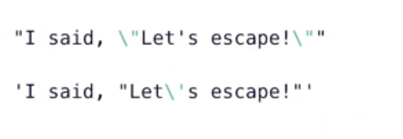
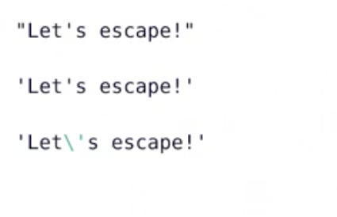
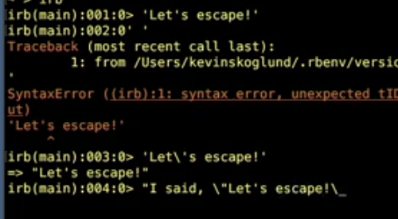
String Escaping

Slide 19
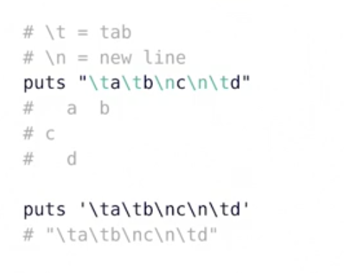
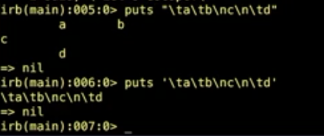
Strings:control Characters

Slide 20
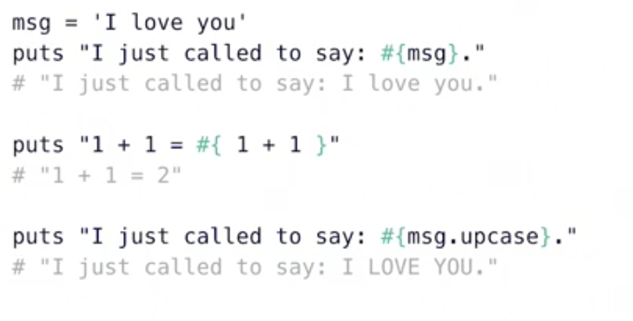
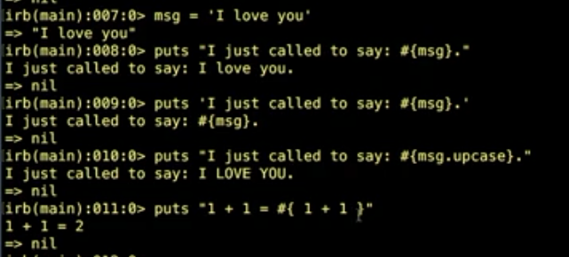
Strings:interpolations

Slide 21

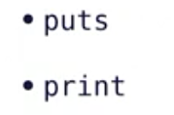
Outputs

Slide 22
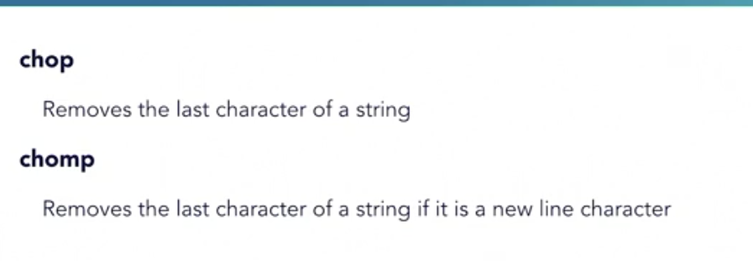
Input gets

Slide 23
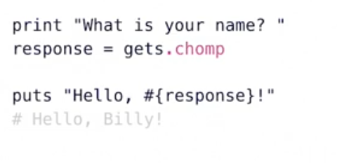
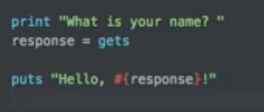

Slide 24
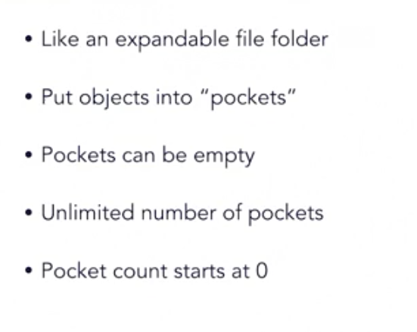
Arrays
An ordered, integer-indexed collection of Object

Slide 25
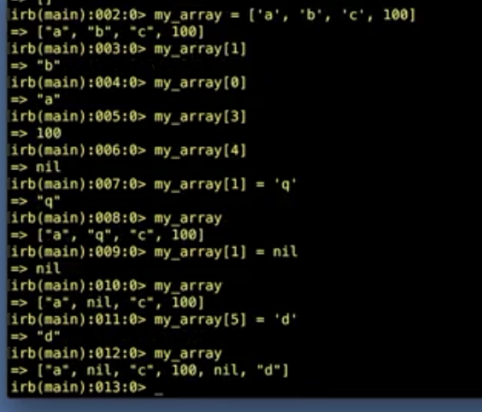
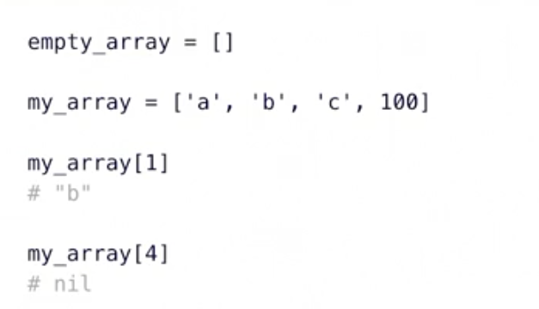
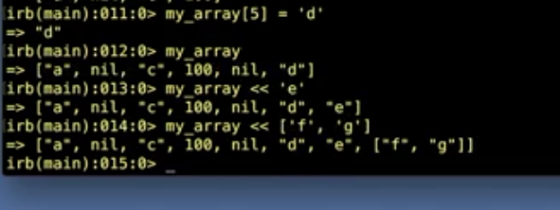

Slide 26
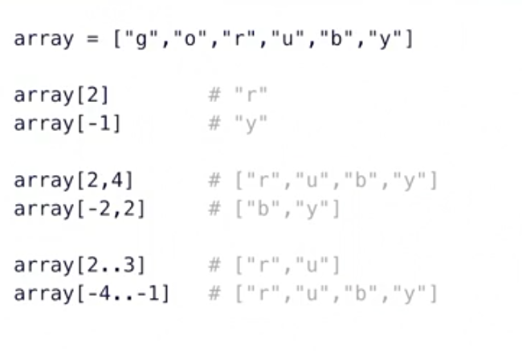
Array[]

Slide 27
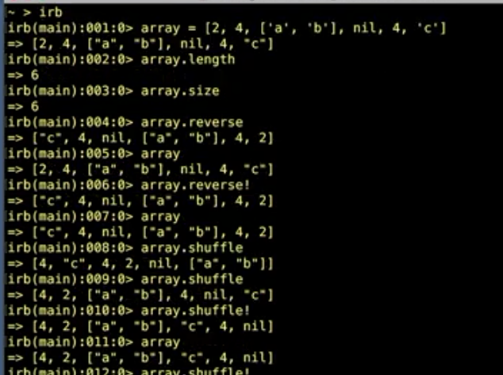
Array Methods
Length
Size
Reverse
Shuffle
Uniq
Compact
Flatten
Include
Delete_at
Delete(”c”)
Join(-)
Split(,)

Slide 28
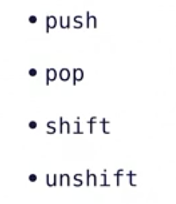

Slide 29
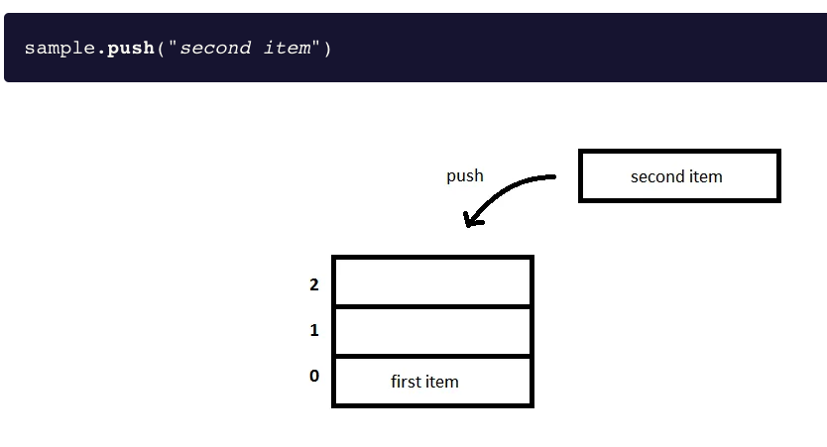
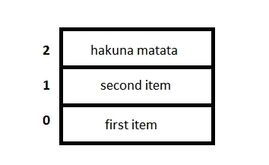
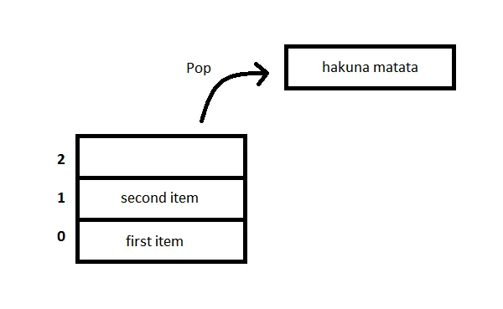

Slide 30
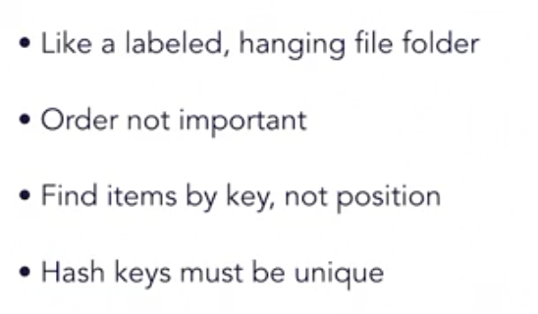
hash
An unordered, object-indexed collection of object(or key values pairs)

Slide 31
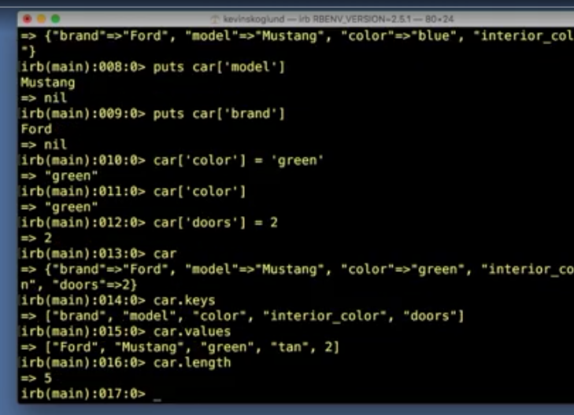


Hashes

Slide 32




symbol

Slide 33


Booleans
An object that is either true or false

Slide 34

Boolean methods
True.class
Includes?(2)
Nil?
Between?
Empety?
Hash. Hash_key?
Has_value

Slide 35


Ranges

Slide 36




Constant

Slide 37


Nil

Slide 38


challenge

Slide 39


Slide 40

Control Structures

Slide 41

Coditionals:if

Slide 42

Coditionals:else

Slide 43


Conditinal:elsif

Slide 44



Conditional: unless

Slide 45


Unless

Slide 46



Conditional : Case

Slide 47


Case with Comparison

Slide 48



Slide 49


Conditional Shorthand operator
Conditional Ternary Operator

Slide 50

Coditional: Or Operator

Slide 51

Loops

Slide 52

Loops: Control Methods

Slide 53

Loops: Example

Slide 54

Loops: while, until

Slide 55

Loops:Example

Slide 56





Slide 57



Slide 58


Slide 59
iterator
Iterate
To say or do again
To apply a procedure repeatedly
To perform code on each item in a set

Slide 60

Iterator:example

Slide 61

Iterator: times,upto, downto, each

Slide 62

Iterator: Block Variable

Slide 63

Iterator:By Classs

Slide 64

Iterators:for .. in

Slide 65



Slide 66



Slide 67

Challenge: Blanket Patterns

Slide 68


Slide 69

Tips

Slide 70



Solutions

Slide 71


Slide 72

Best Practices
Give Ruby files an .rb extension
Put shebang line at the top
#!/usr/bin/env ruby

Slide 73

Block Variable
|a|

Slide 74


Exit a Running Script
Automatically, after the las line of code

Slide 75
Challenge .- Guessing Game
Ask Player for their name
Say hello and explain rules
Pick a random number
Get player`s guess
Tell player if guess is correct
Loop to allow three guesses

Slide 76
Rand
#returns a float in 0.01 .. 1.00
Rand 100
Returns and intenger in 0..99
number=rand(10)
1.upto()
if

Slide 77


Slide 78

Solutions

Slide 79


Enumerables

Slide 80


Slide 81

Enumerable:Methods

Slide 82


Code Block

Slide 83

Code Block:Format

Slide 84


Code Blocks: Block Variable

Slide 85

Block Variable

Slide 86


Slide 87


Local vs Block Variable

Slide 88

Code Blocks: Common usage

Slide 89

Code block

Slide 90

Find Methods

Slide 91


Slide 92


Slide 93

Map Methods

Slide 94


Slide 95


Slide 96


Slide 97



Slide 98


Slide 99


Slide 100


Slide 101


Slide 102

Inject Methods

Slide 103



Slide 104


Slide 105


Slide 106



Slide 107


Slide 108


Slide 109


Slide 110


Slide 111


Comparison Operator

Slide 112


Comparison Operator

Slide 113

Sort Methods:sort

Slide 114


Slide 115

Sort Methods:sort_by

Slide 116

Sort Methods:without < = >

Slide 117

Sort methods

Slide 118

Sort methods

Slide 119

Sort methods :sorting hashes

Slide 120


Slide 121

Merge methods

Slide 122

Merge:without a block

Slide 123

Merge:with a block

Slide 124

Merge:with a block

Slide 125

Merge!

Slide 126


Slide 127

CHALLENGE RUBY _BLANKS

Slide 128

CHALLENGE RUBY _BLANKS

Slide 129


Slide 130


Slide 131

Define and call methods

Slide 132

Define and call methods

Slide 133

Methods name

Slide 134




Slide 135


Slide 136
Methods
Instructions to perfomos a specific task, package as a unit
Can be defined once and called multiples times
Don’t repeat yourself(DRY)

Slide 137

Methods

Slide 138




Slide 139

Variable Scope Indicator

Slide 140

Variable Scope

Slide 141


Slide 142

Arguments

Slide 143

Arguments

Slide 144

Arguments Parentheses

Slide 150

Online Documentations
https://www.ruby-lang.org/es/

Slide 151

Online documentación
https://ruby-doc.org/

Slide 152


Comand line Documentation

Slide 153
Ruby on Rails
Open sources web application framework
Written in Ruby
Created in 2003 by David Heinemeier Hansson(DHH)
Foundation of Basecamp
Released as open source in 2004

Slide 154
MVC Architecture
Model (the data object)
View(presentation layer)
Controller(user events)

Slide 155

Basic Web Architecture

Slide 156

MVC Web Archictecture

Slide 157
Launch a ruby on Rails Project
Create (or download) project
Create databases
Configure project to use databases
Run bundle install

Slide 158

Destiny is here

